Slide 1

G2M Case Study July 2022

Slide 2
Business Problem:
XYZ is a private firm in the US. Due to remarkable growth in the Cab Industry in the last few years and multiple key players in the market, it is planning for an investment in the Cab industry and as per their Go-to-Market(G2M) strategy they want to understand the market before taking a final decision.

Slide 3
INSTRUCTIONS FOR USE
Preprocessing
The first part is including merging datasets and doing the best data cleaning.
Also, you will find out why we add many columns to the data for better analysis.
Finally, you will be informed that we have 10 attributes to start our analysis.
Analysis
The second part includes all the analysis to prove that is it profitable to invest in this industry.
Additionally, you will be informed which company is doing great in the US.
At the end, we will present all the results as a conclusion part.

Slide 4
HELLO!
I am Seyed Mojtaba Hejazi
I am here because I would like to share with you my analysis of cab industry datasets.

Slide 5
Preprocessing
1

Slide 6
1- Preparing Dataset and merging all we have
For the first step, we need to take a look at the dataset to fully understand the data and start doing what we need to do as preprocessing operation.
We have four datasets:
cab_data which is referred to represent each transaction with six attributes{Date of Travel, Company, City, KM Travelled, Price Charged, Cost of Trip}.
Customer_ID which is related to all attributes of the customers{Age, Gender, and Income).
Transaction_ID which represents the relation between each transaction and customer and how they paid(cash or by card).
City which is about the cities(population, the number of users).

Slide 7
After Carefully preprocessing, we have 12 Attributes which we want to work on it.
Gender
Company
City
KM Travelled
Price Charged
Cost of Trip
Payment_Mode
Month of travel
Day of travel
Year of travel
Age Group
Salary Group

Slide 8
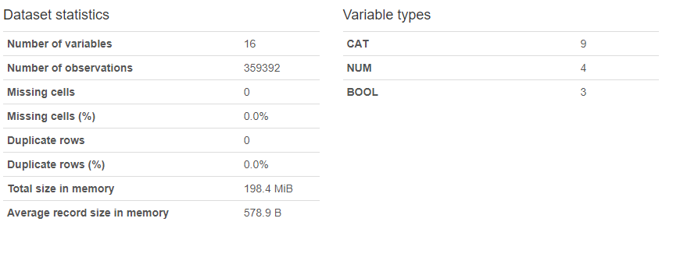
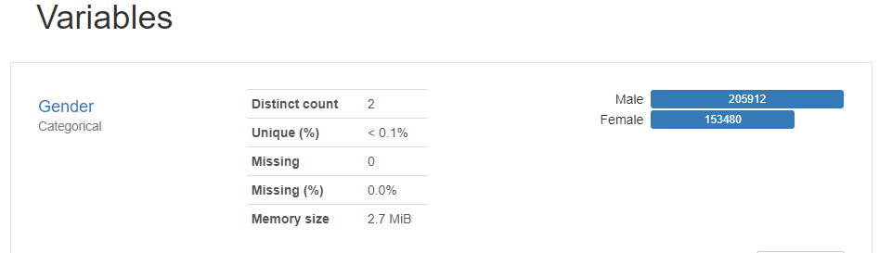
In this step, we need to understand our data. Let’s take a look at that and do some statistical analysis.

Slide 9
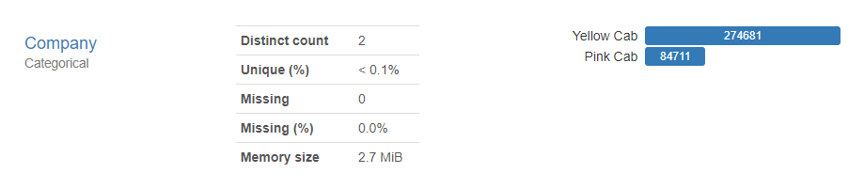
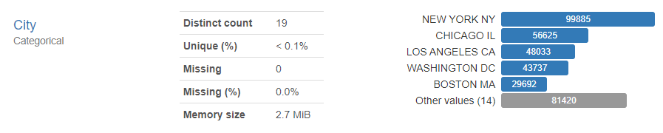
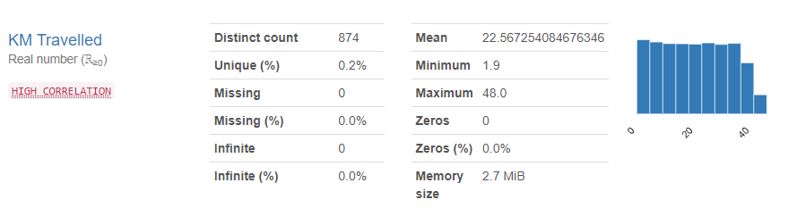
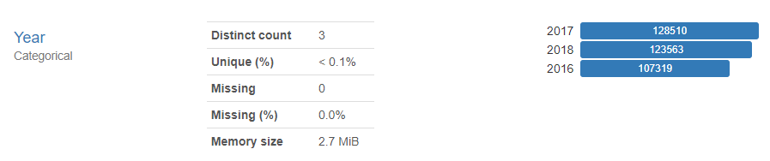
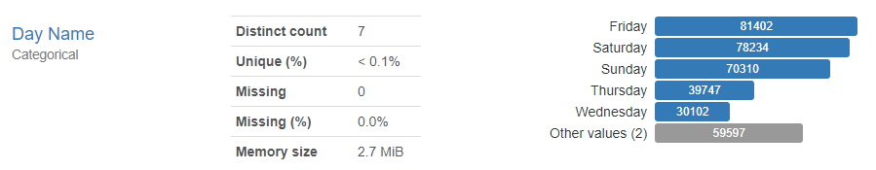

Slide 10
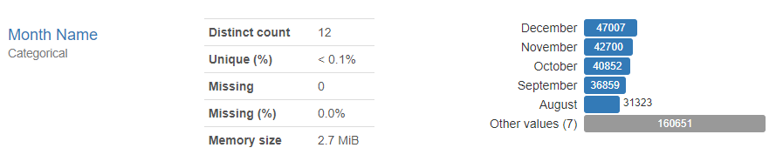
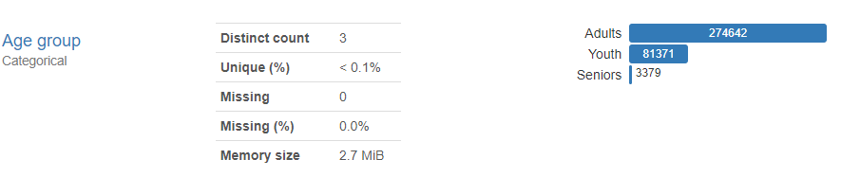
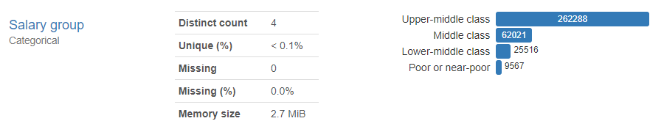

Slide 11
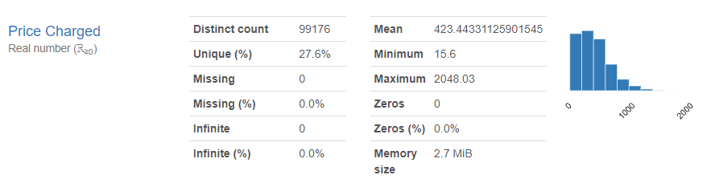
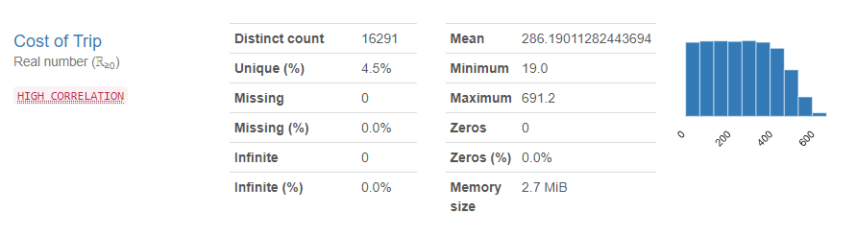

Slide 12
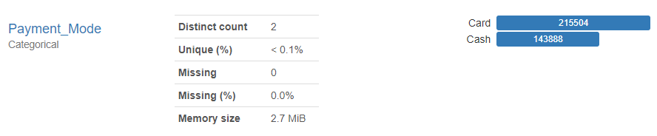
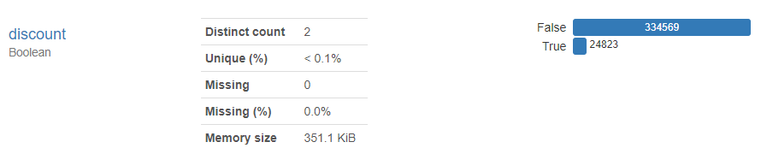
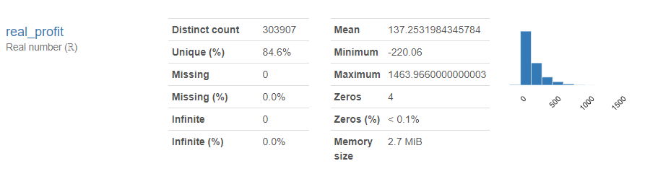

Slide 13
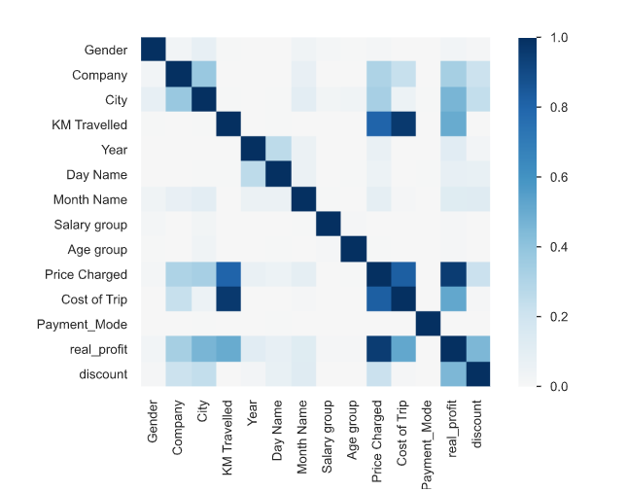

Slide 14
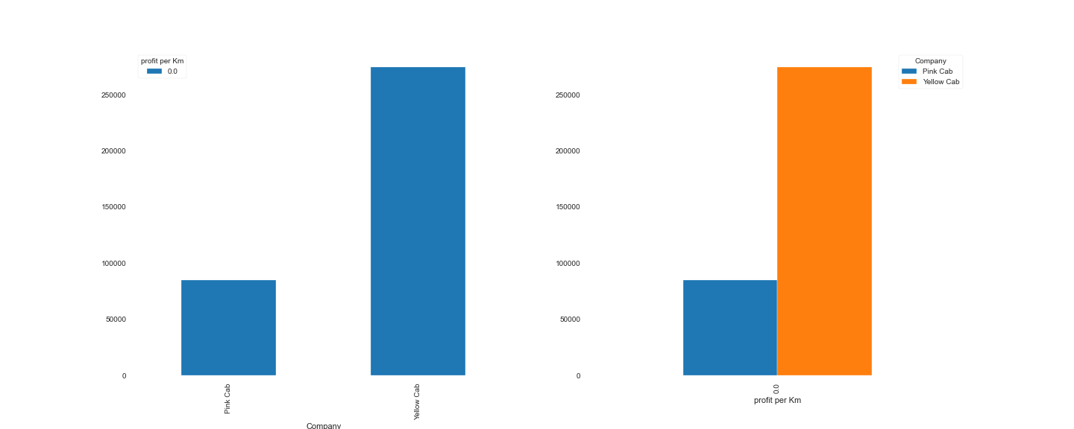
Of course, as you see in the figure, the yellow cab company was more profitable in this industry.
Profit for each company

Slide 15
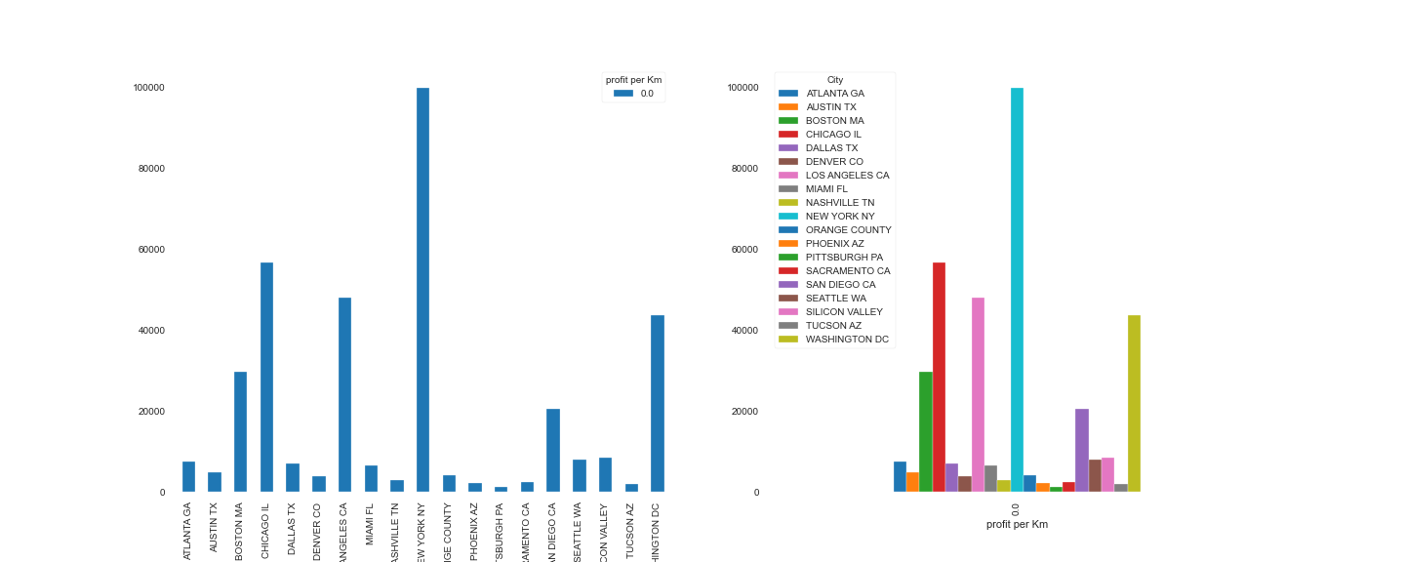
According to this plot, New York city
Is the best city for starting a running company.
Profit for each City

Slide 16
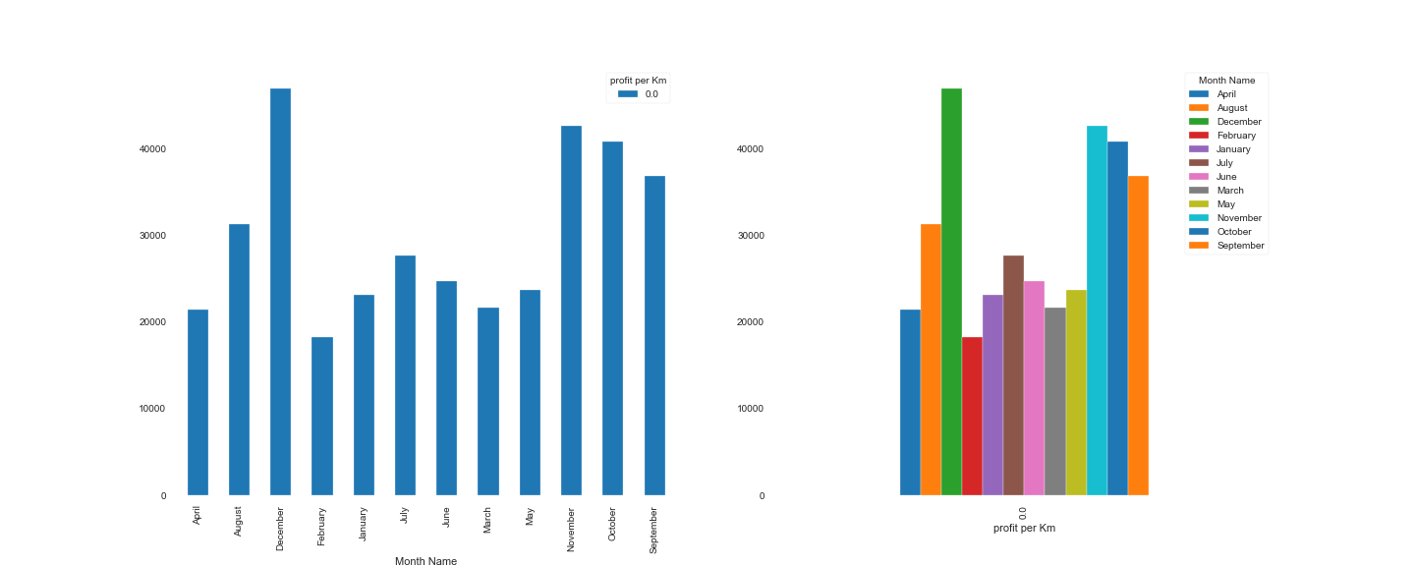
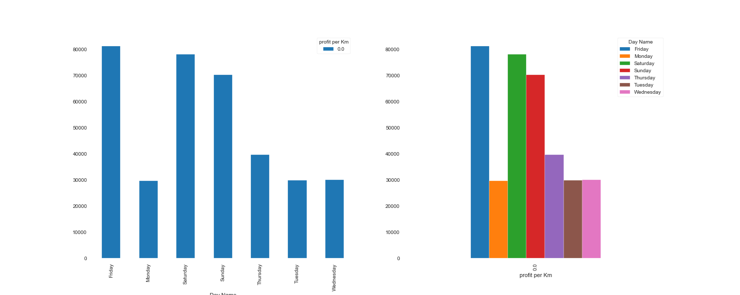
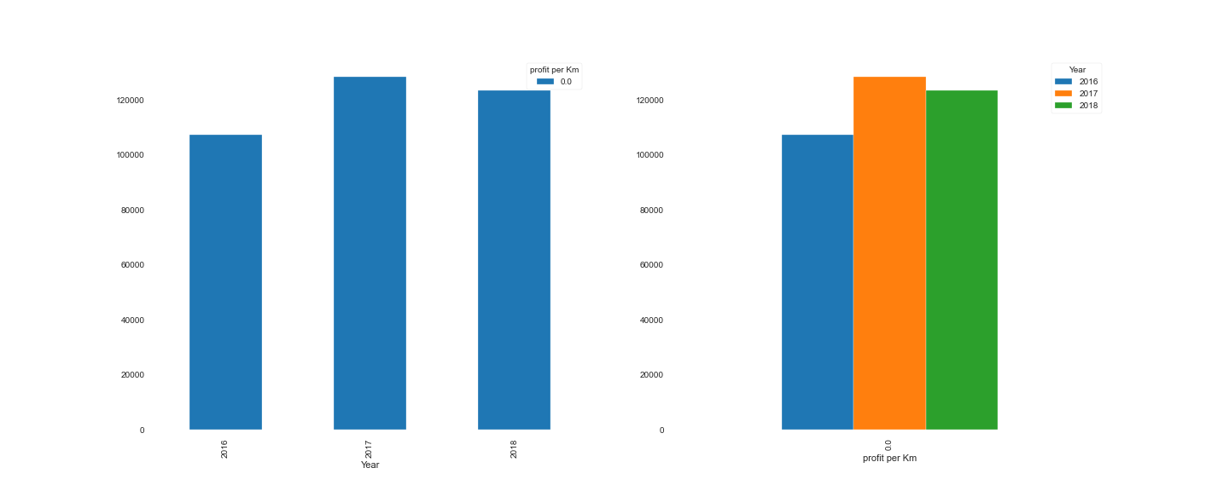
Profit for each Month
Profit for each Day
Profit for each Year

Slide 17
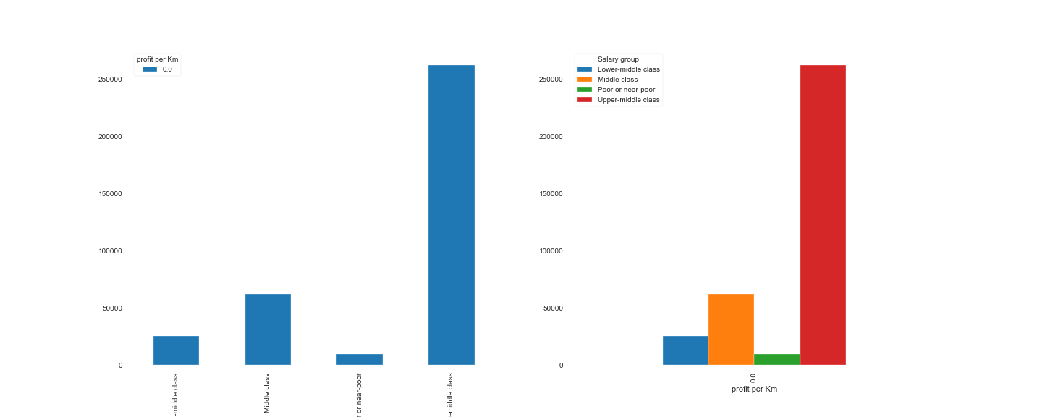
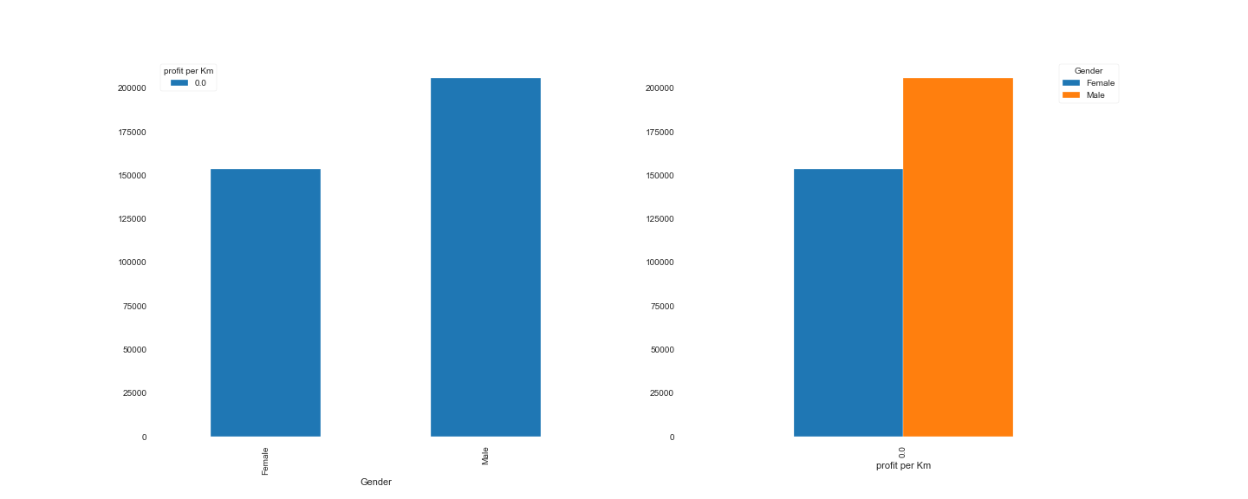
Profit for each Salary group
Profit for each Gender

Slide 18
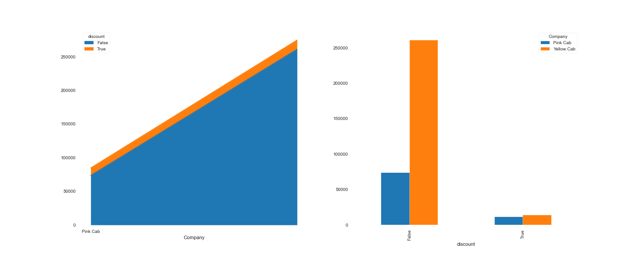
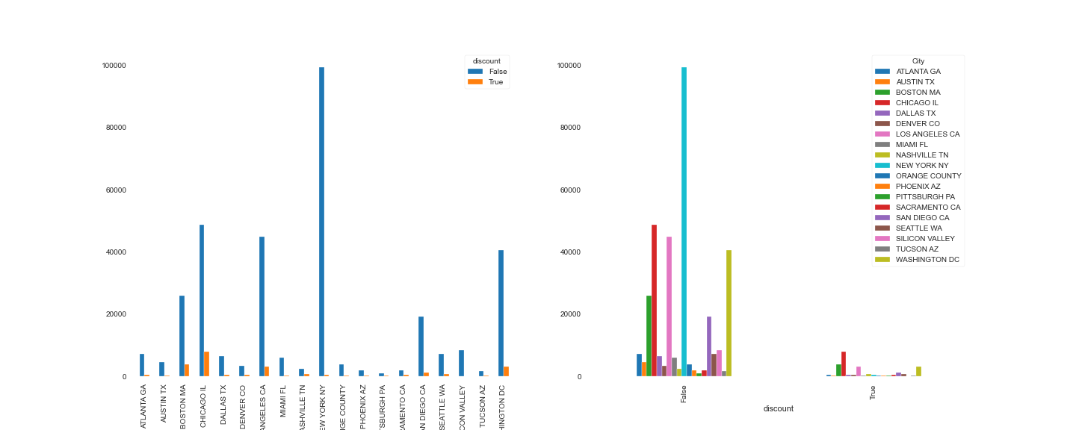
Discount has been given by each company
Discount has been given in each city

Slide 19
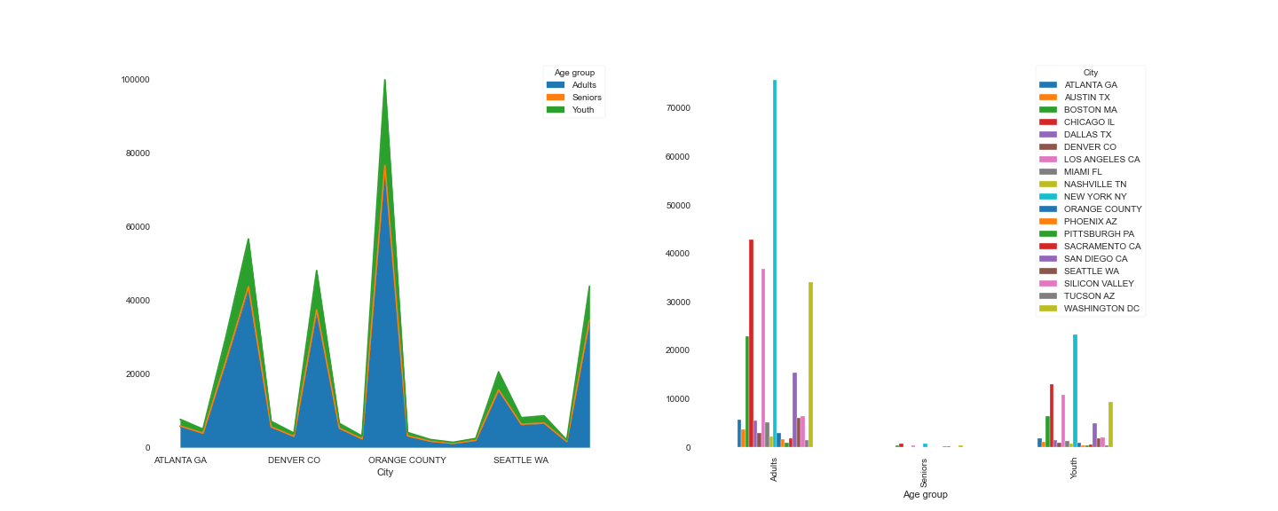
Number of travel for each age group in each city

Slide 20
THANKS!
Any questions?
You can find me at
Mojtaba.hejazi991368@gmail.com

